Slide 1
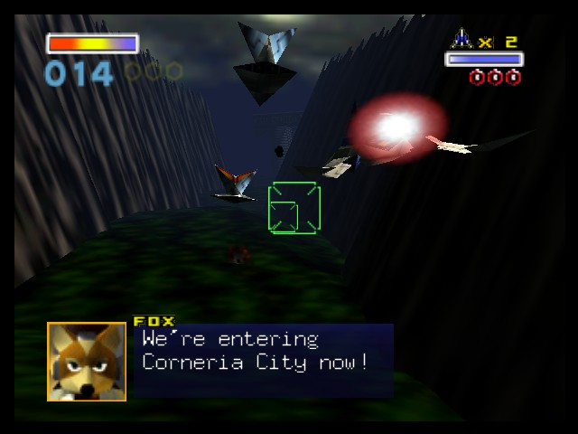
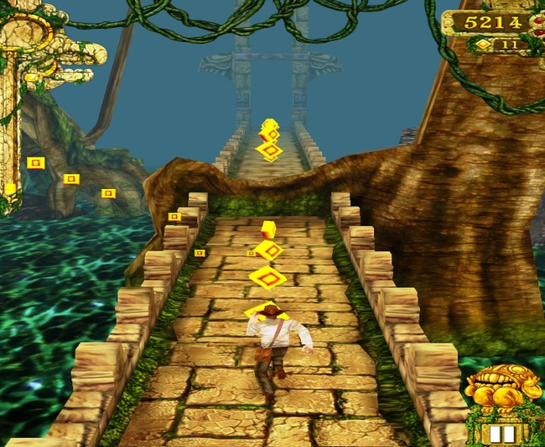

Death-rone
Image from: http://tinyurl.com/qf7gh5j
Image from: http://tinyurl.com/obn3tjs

Slide 2
Why?
Gameplay that is fast and fluid.
Linear style progression.
Different maps and bosses.

Slide 3
Target Market?
People who enjoy linear gameplay action.
People who enjoy non-convoluted stories.
Gamers on the go.

Slide 4
So...what’s different/unique?
Simple control scheme.
Levels progress on-rail style, with end boss battle.
Players choose different levels/bosses to fight, similar to Megaman games.

Slide 5
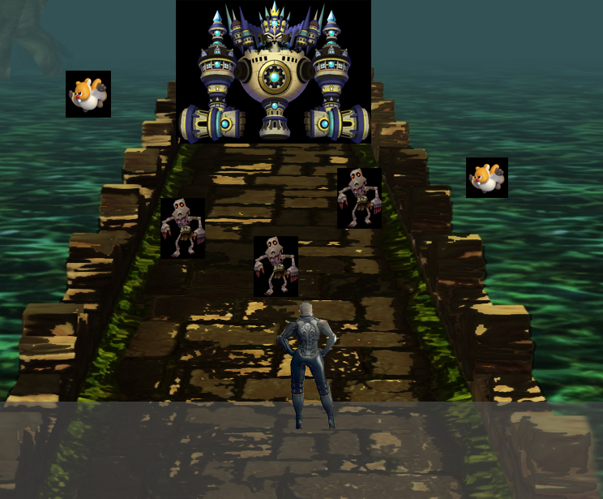
Concept Art
Final Boss of the stage
Combination of flying and ground enemies
Player swipes area to cut, or tap to fire projectile, destroying the enemies.
Grey Area: Player movement Area (left/right/jump)

Slide 6
Why back it?
Emphasis on simple storyline, simple gameplay.
No advantageous benefits via monetary payments.

